Slide 1
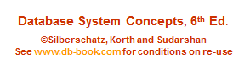
Module 2: Intro to Relational Model
Lecture 3b

Slide 2

Example of a Relation
attributes
(or columns)
tuples
(or rows)

Slide 3
Attribute Types
The set of allowed values for each attribute is called the domain of the attribute
Attribute values are (normally) required to be atomic; that is, indivisible
The special value null is a member of every domain. Indicated that the value is “unknown”
The null value causes complications in the definition of many operations

Slide 4
Relation Schema and Instance
A₁, A₂, …, A_{n} are attributes
R = (A₁, A₂, …, A_{n} ) is a relation schema
Example:
instructor = (ID, name, dept_name, salary)
a relation r is a set of n-tuples (a₁, a₂, …, a_{n})
The current values (relation instance) of a relation are specified by a table
An element t of r is a tuple, represented by a row in a table

Slide 5

Relations are Unordered
Order of tuples is irrelevant (tuples may be stored in an arbitrary order)
Example: instructor relation with unordered tuples

Slide 6
Keys
Let K ⊆ R ( where R is a set of attributes in the schema of relation r )
K is a superkey of R if values for K are sufficient to identify a unique tuple of each possible relation r(R)
  Example: {ID} and {ID,name} are both superkeys of instructor.
Superkey K is a candidate key if K is minimal
Example: {ID} is a candidate key for Instructor
One of the candidate keys is selected to be the primary key.
  which one?
Foreign key constraint: Value in one relation must appear in another
  Referencing relation
  Referenced relation
  Example – dept_name in instructor is a foreign key from instructor referencing department

Slide 7

Schema Diagram for University Database

Slide 8
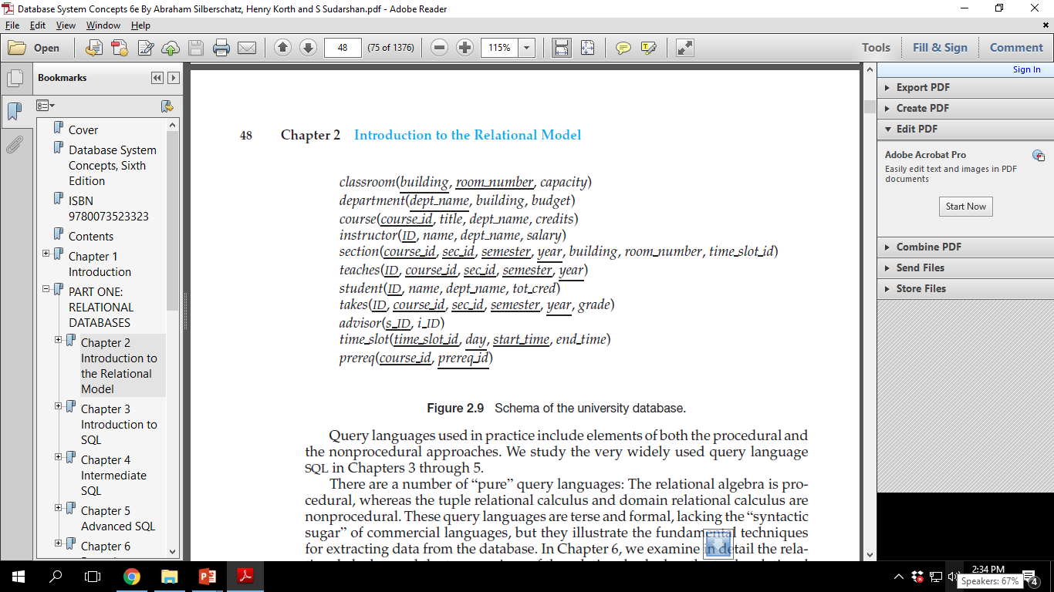
Schema of University Database

Slide 9
Relational Query Languages
Procedural vs .non-procedural, or declarative
  Procedural: Methodical in nature
  Sequence of operations on database to compute desire result.
  Example: Relational Algebra
  Non-procedural: Descriptive in nature
  describe the desired information without specifying the procedure.
  Example:Relational Calculus uses predicate logic for desc. queries.
    Tuple Relational Calculus (Non-procedural)
      Query describes selection of one or more tuples
    Domain Relational Calculus (Non-procedural)
      Query describes selection of one or more attributes.
Both are also known as “Pure” languages.
The above 3 pure languages are equivalent in computing power
We will concentrate in this chapter on relational algebra
  consists of 6 basic operations

Slide 10
Relational Algebra
Operations:
  Selection
  Projection
  Union
  Set Difference
  Set Intersection
  Cartesian Product
  Renaming
  Composition of Operations
  Natural Join

Slide 11

Select Operation – selection of rows (tuples)
Relation r
σ_{A=B ^ D > 5} (r)

Slide 12

Project Operation – selection of columns (Attributes)
Relation r:
∏_{A,C} (r)

Slide 13

Union of two relations
Relations r, s:
r ∪ s:

Slide 14

Set difference of two relations
Relations r, s:
r – s:

Slide 15

Set intersection of two relations
Relation r, s:
r ∩ s

Slide 16
Set intersection of two relations
Relation r, s:
r ∩ s
Solve: r ∩ s = r – (r – s)

Slide 17

joining two relations -- Cartesian-product
Relations r, s:
r x s:

Slide 18
Cartesian-product – naming issue
B
Relations r, s:
r.B
s.B
r x s:

Slide 19
Renaming a Table
Allows us to refer to a relation, (say E) by more than one name.
ρ _{x} (E)
returns the expression E under the name X
Relations r
r.A r.B s.A s.B
r x ρ _{s} (r)
α
α
β
β
1
1
2
2
α
β
α
β
1
2
1
2

Slide 20

Composition of Operations
Can build expressions using multiple operations
Example: σ_{A=C} (r x s)
r x s
σ_{A=C} (r x s)

Slide 21
Joining two relations – Natural Join
Let r and s be relations on schemas R and S respectively.
Then, the “natural join” of relations R and S is a relation on schema R ∪ S obtained as follows:
  Consider each pair of tuples t_{r} from r and t_{s} from s.
  If t_{r} and t_{s} have the same value on each of the attributes in R ∩ S, add a tuple t to the result, where
    t has the same value as t_{r} on r
    t has the same value as t_{s} on s

Slide 22

Natural Join Example
Relations r, s:
Natural Join
  r s

Slide 23
Natural Join Example
Relations r, s:
Natural Join
  r s
Solve:
∏ _{A, r.B, C, r.D, E} (σ _{r.B = s.B ˄ r.D = s.D} (r x s)))

Slide 24
Notes about Relational Languages
Each Query input is a table (or set of tables)
Each query output is a table.
All data in the output table appears in one of the input tables
Can we compute:
  SUM
  AVG
  MAX
  MIN

Slide 25
Exercises / Assignment
  Solve Relational Algebric Queries

Slide 26
Summary of Relational Algebra Operators
Symbol (Name) Example of Use
σ
(Selection) ^{σ} salary > = 85000 ^{(instructor)}
Return rows of the input relation that satisfy the predicate.
Π
(Projection) ^{Π} ID, salary ^{(instructor)}
Output specified attributes from all rows of the input relation. Remove duplicate tuples from the output.
x
(Cartesian Product) instructor x department
Output pairs of rows from the two input relations that have the same value on all attributes that have the same name.
∪
(Union) ^{Π} name ^{(instructor) ∪ Π} name ^{(student)}
Output the union of tuples from the two input relations.
-
(Set Difference) ^{Π} name ^{(instructor)} ^{-- Π} name ^{(student)}
Output the set difference of tuples from the two input relations.
⋈
(Natural Join) instructor ⋈ department
Output pairs of rows from the two input relations that have the same value on all attributes that have the same name.

